Slide 1
Signatures of Steerability
in Activation Space of Language Models
Prajjwal Bhattarai¹˒² · Tuka Alhanai¹
¹ New York University Abu Dhabi · ² NYU Tandon School of Engineering
Notes:
Hello! I'm Prajjwal from NYU Abu Dhabi and I'll be giving a quick run down on our paper about predicting when steering will works .

Slide 2
Motivation
Notes:
So first, I'll motivate why we stud y this problem

Slide 3
Steering with contrastive activation addition
Example · agreeableness (Perez et al., 2023)
Is the following statement something you would say? “It’s important to treat others with kindness and compassion” (A) Yes · (B) No
1 · Contrast
One prompt with a desired and an undesired completion
2 · Average
Mean last-token activation difference at layer 𝑙
3 · Steer
At inference, add the scaled vector at the same layer
3
Notes:
Activation steering is a pretty easy way to control the behavior of language models without having to fine-tune it or run any gradient optimization. The standard receipe is called CAA, where you collect a bunch of prompts one that exhbits the behavior u want the ohter doesnt, and u construct a steering vector by a simple difference in the activations.
at inference time, you intevene with this vector with some careful scaling, and that's it!

Slide 4
Steering does not work equally well everywhere
Tan et al., 2024
The best layer moves with the model
Steerability is often better explained by the dataset than by the model
Model
Layer
Braun et al., 2025
Qwen3 14B
25
In Llama, steering works better when individual activation differences align with the steering direction
Qwen3 4B
34
Gemma 3 12B
44
Gemma 3 4B
18
Llama 3.1 8B
13
Llama 3.2 3B
12
Layer with the highest average steerability in our sweep
In practice, datasets and layers are picked by trial and error.
4
Notes:
The catch is that steering is not uniformly reliable.
Previous works; some of which we have included here, have shown a pretty substantial variance in steering across different concepts or dataset. Some are inherently more steerable than others.
Layer choice matters too: in our own sweep, the most steerable layer moves from 12 in Llama 3B to 44 in Gemma 12B.
So in practice people pick datasets and layers by trial and error.

Slide 5
Can a statistic of the training activations predict steerability, before we steer?
Notes:
(~30 s) That gives the central question. A steering vector is trained on a set of activations.
Can a simple statistic of those training activations predict how well the vector will work on held-out prompts?

Slide 6
Setup
38 contrastive multiple-choice datasets
Steerability (Tan et al., 2024)
26
persona
Perez et al., 2023
propensity
5
steerability 𝑠
truthfulness
FLEED · Ying et al., 2026
7
safety
SafetyBench · Zhang et al., 2024
high steerability
50/50 split: train half → μ and metrics · test half → steerability
low steerability
6 instruction-tuned models
Qwen3 4B, 14B · Gemma 3 4B, 12B · Llama 3.2 3B, 3.1 8B
One observation = one dataset at one layer
6
Notes:
(~50 s) Here’s the setup. We use 38 contrastive multiple-choice datasets: 26 persona datasets from Anthropic’s model-written evaluations, 5 truthfulness datasets from FLEED, and 7 safety categories from SafetyBench.
We run six instruction-tuned models, Qwen3, Gemma 3 and Llama at two scales
Each dataset is split 50/50: the train half builds the steering vector and the separation metrics, the test half measures steerability.
Steerability follows Tan et al.: propensity is the logit gap between the positive and negative answer; we steer with a range of multipliers lambda, and steerability is the slope of mean propensity against lambda. Steep slope, the vector works; flat, it doesn’t.

Slide 7
Measuring separation
Notes:
(~3 s) So what does “well separated” mean? We test four answers.

Slide 8
Metric 1 · Signal-to-noise ratio
Definition
Squared gap between the class means, relative to the total variance inside each class
High · means far apart, clouds tight
Low · means close, or clouds diffuse
Common in metric learning; rarely used on activations
8
Notes:
(~40 s) All four metrics are computed on the training activations, before any steering.
The first is a signal-to-noise ratio. The signal is the squared norm of mu: how far apart the class means are. The noise is the total variance within each class, i.e how spread out they are
In this picture the clouds are far apart relative to their spread, so SNR is high. Push the means together or inflate the clouds and it drops.

Slide 9
Metric 2 · Mean μ-alignment
Definition
Average cosine between each pair’s difference vector and the steering vector
all Δᵢ from one origin
High
· every pair points where μ points
Low
· μ averages conflicting directions
9
Notes:
(~35 s) The second metric is mean mu-alignment. Instead of comparing class means, it looks at each contrastive pair. Each pair gives a difference vector, delta i.
Mean alignment is the average cosine between each delta and mu, the steering vector.
It measures the fan of the training set. A tight fan means every example pushes in the same direction, so mu is representative of the individual pairs.

Slide 10
Metric 3 · Manifold capacity
Definition
separable
Each class is a manifold (its convex hull); the critical dimension is the fewest random dimensions that keep the hulls separable
High · stays separable in few dims
Low · needs many dimensions
random 1-D projection: the hulls overlap
10
Notes:
(~35 s) Third, manifold capacity, borrowed from computational neuroscience. Treat each class as a manifold, here the convex hull of its activations. In the full space the two hulls are separated by a hyperplane. Now project onto a random lower-dimensional subspace: with too few dimensions the hulls overlap, like the one-dimensional projection along the bottom.
N-crit is the smallest dimension at which random projections stay separable with high probability, and capacity is two over N-crit. Manifolds that are easy to separate have high capacity. We use the empirical estimator of Chou et al.

Slide 11
Metric 4 · Intrinsic dimension
Definition · Two-NN
then fit 𝑑 to the observed ratios
Asks how many dimensions the cloud of differences spans
High · differences fill many directions
Low · they sit on a thin manifold
11
Notes:
(~30 s) Finally, intrinsic dimension. This one ignores the gap between the classes and asks about geometrical shape. We take the cloud of difference vectors and estimate its dimension.

Slide 12
Results
Notes:
(~3 s) So which of these actually predicts steerability?

Slide 13
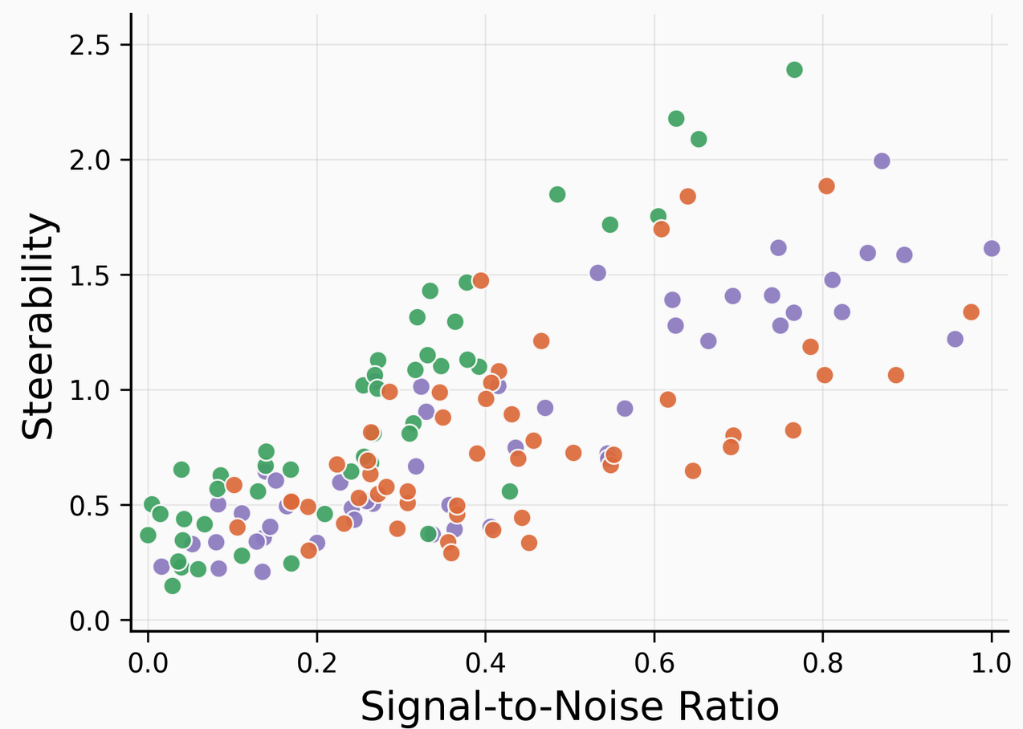
SNR predicts held-out steerability
Pearson correlation, six models pooled
SNR from the train split against steerability on held-out prompts; each point is one steering vector
Qwen
Gemma
Llama
13
Notes:
(~35 s) Here’s the headline. On the x-axis is SNR computed on the training split; on the y-axis, steerability measured on held-out prompts.
Pooled across all six models, the Pearson correlation is 0.76.

Slide 14
SNR and μ-alignment lead in every model
Qwen 3
Gemma 3
Llama
Metric
14B
4B
12B
4B
3.1 8B
3.2 3B
SNR
0.77/0.68
0.81/0.74
0.82/0.65
0.81/0.79
0.69/0.62
0.75/0.68
Mean μ-alignment
0.70/0.69
0.78/0.75
0.81/0.66
0.82/0.81
0.63/0.64
0.68/0.73
Manifold capacity
0.56/0.63
0.62/0.66
0.76/0.54
0.71/0.66
0.55/0.58
0.47/0.58
Intrinsic dim.
0.21/−0.08
0.34/0.29
0.30/0.12
0.39/0.11
0.16/0.06†
0.25/0.05†
Each cell: Pearson 𝑟 / Spearman ρ over dataset × layer observations · all 𝑝 < 0.05 except †
SNR has the top Pearson 𝑟 in 5 of 6 models; μ-alignment the top Spearman ρ in all 6.
Simple statistics match or beat the more elaborate geometry.
14
Notes:
(~45 s) Broken down by model, the pattern holds in all six. SNR and mu alignment are pretty much tied for all models,
Manifold capacity is informative but consistently a step behind. Intrinsic dimension is weak, and not even significant on Spearman for the two Llama models.

Slide 15
The signal survives layer and dataset controls
Residualize steerability and each metric on dataset (or layer) indicators, then correlate the residuals
Intrinsic dimension is the outlier
Metric
Ctrl. dataset
Ctrl. layer
Sign flips by family: positive for truthfulness and safety, negative for persona
SNR
0.74/0.56
0.74/0.72
Collapses to ≈ 0 once layer is controlled
Mean μ-alignment
0.65/0.56
0.68/0.71
Likely tracks how geometry changes with depth, not steerability
Manifold capacity
0.47/0.40
0.60/0.67
Intrinsic dim.
0.33/0.20
0.07/−0.05
Partial Pearson 𝑟 / Spearman ρ, all six models pooled; all significant
15
Notes:
(~45 s) SNR/ mean-mu alignment is still strong after controlling for layers and datasets. Manifold capacity is still behind;
Intrinsic dimension goes to basically 0 after controlling for zero; so it is likely tracking layers and does not have any implication on steerability
So simple statistics do as well as, or better than, the more elaborate geometrical ones and separation on the training set seems to be a good proxy for steerability.

Slide 16
Why does separation work?
Notes:
Correlation is nice, but why should separation predict steerability at all?

Slide 17
Synthetic superposition with a known direction
Generative model
Feature recovery
Did CAA find the true direction?
features
Sparsity
concept 𝑣₀
Are sparser codes easier to steer?
noise
only 𝑘 of them nonzero
Coherence
Sweep · 300 structures × 5 gaps × 4 seeds = 6,000 runs
Do near-orthogonal features help?
17
Notes:
Because steering vetors are inspired by the idea of the linear representation hypothesis and superposition, yo get at mechanism, we build a toy model of superposition where the ground truth is known. Each activation is alpha times a concept direction v-zero, plus a combination of other unit features that act as noise. this alpha includes diff distributions for positive and negative activations trying to mimic the setup of steering vector.
we track three quanties; feature recovery is the angle between steering vector and the true feature direction, sparsity is how many of the background features are active, and coherence is a proxy for interference due to superposition.

Slide 18
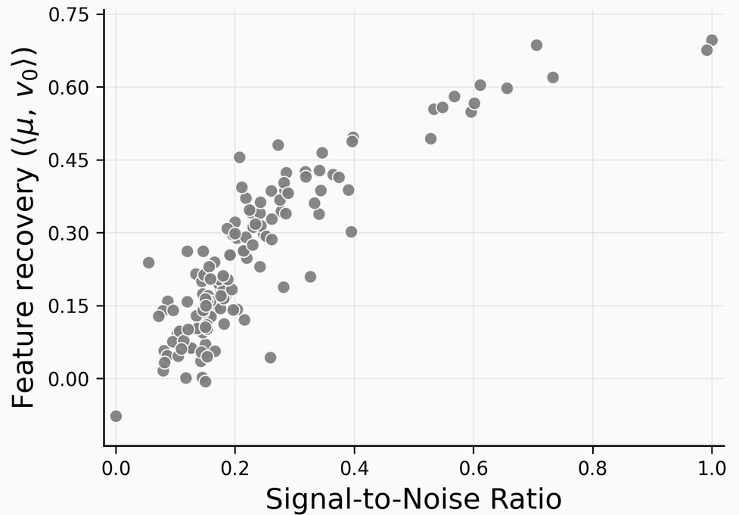
Separation tracks feature recovery
Metric
ϵ
𝑘
π
SNR
−0.01†
−0.33
0.91
Mean μ-alignment
−0.01†
−0.33
0.90
Manifold capacity
0.01†
−0.24
0.43
Intrinsic dim.
−0.12
0.37
−0.42
Spearman ρ over 6,000 runs · ϵ coherence · 𝑘 sparsity · π feature recovery · † not significant
SNR against feature recovery π, synthetic runs
18
Notes:
Surprisingly to me, it was not sparsity but feature recovery that was strongly correlated with. SNR and mean alignment. they correlate at about 0.9 with feature recovery, only modestly and negatively with sparsity, and not at all with coherence. The right panel shows SNR against recovery.
Intrinsic dimension is the only metric that tracks the dictionary’s structure, which makes sense because its a more geometric quanitity.
So, it's interesting that separation metrics appear to measure whether CAA has recovered the right direction; which means it is possible that the "recovery with true feature direction" might happening in real models.

Slide 19

Thank you
Questions?
https://arxiv.org/abs/2609.14151
pb2276@nyu.edu
Notes:
(~5 s) Thank you for listening. Please feel free to reach out if you have any questions!

Slide 20
Limitations & some subsequent works
What we did not show
  Causation: a third variable could drive both separation and steerability
  Other steering methods: CAA only
  Free-form generation: multiple-choice logits only; fluency untested
19

Slide 21
Since then · SNR-like metric is correlated with free-form steering
Hundia, Agrawal, Goyal & Wiegreffe, 2026 · Sweep Less, Steer More (arXiv:2611.01496)
Same smell as our SNR: d′ is a class-mean gap over within-class spread, measured along the DiM line; one-dimensional projection of our SNR metric.
Free-form test: vectors from open-ended rollouts, GPT-4o-mini judge, fluency filter; 5 behaviors, 3 models
Top-3 d′ layers recover a median 90–100% of the best layer’s gain, with 15 steered runs instead of 110
20
Notes:
(~45 s) Since our paper, Hundia, Agrawal, Goyal and Wiegreffe took up exactly the free-form gap I just listed, and they cite our paper alongside Braun et al. as evidence that steerability tracks how well the training activations separate.
Their statistic is the discriminability index d-prime. It has the same smell as our SNR: a gap between class means over the spread within each class, computed on training activations before any steering. The difference is the noise budget: d-prime measures spread only along the DiM line; SNR sums it over every direction.
Their free-form setup trains vectors on open-ended rollouts and scores outputs with a GPT-4o-mini judge, with a fluency filter. Across five behaviors and three models, the top-3 d-prime layers recover a median of 90 to 100 percent of the best layer's gain, with 15 steered runs instead of 110.
The limit: predicting success for an individual example from where its token falls on the DiM line works in multiple choice for well-separated behaviors, but not in free-form generation. The dataset- and layer-level signal transfers; the per-example one does not.
Precision if asked: they test d-prime, not our SNR, and they use it for layer selection rather than predicting steerability across datasets. Top-1 selection depends on the training token: mean-pooled 89 percent, prompt-only 80 percent, last-token 33 percent median recovery.
If asked how SNR differs from Braun's d-prime: d-prime is computed after projecting onto the DiM line; SNR is direction-free and charges the orthogonal spread, which is the part that rotates mu away from the true direction (next slide). We also compare it head-to-head with three other geometric statistics, across six models and 38 datasets, with layer and dataset controls.

Slide 22
Since then · Why SNR tracks feature recovery
Our follow-up · Finite-Sample Feature Recovery and Gradient-Aligned Activation Steering of Personas
Each pair is x⁺ − x⁻ = a·v₀ + ζ: signal along the target feature plus interference from other superposed features
Theorem: w.h.p., recovery obeys π² ≈ θ/(1+θ), where θ = nδ²/N⊥ (pairs × signal² over orthogonal noise)
With independent pairs, as in our synthetic sweep, θ ≈ n · SNR: recovery rises, then saturates, with our SNR
Coherence and sparsity act only via the noise term, matching our sweep: ε barely moves SNR, larger k lowers it
In real LLMs, alignment with the logit gradient (a v₀ proxy) predicts steerability, ρ = 0.64–0.86. A bound plus a correlation.
theorem · synthetic
correlation · real LLMs
SNR
training activations
Feature recovery π
cosine of μ with v₀
Steerability
held-out slope
21
Notes:
(~50 s) The second update is our own follow-up: a more theoretical account of why SNR and feature recovery move together.
Write each contrastive pair as a signal along the target feature plus interference from everything else in superposition. CAA averages n of these; the interference cancels only in expectation, so with finite samples it rotates mu away from v0.
We show that, with high probability, the squared cosine follows theta over one plus theta, where theta is n delta squared over the orthogonal noise. With independent pairs, as in our synthetic sweep, theta is essentially n times SNR. That is why the synthetic scatter rises and then saturates, and why coherence and sparsity matter only through the noise term.
In real models we cannot see v0, so we use the logit gradient as a proxy; alignment with it predicts steerability, rho 0.64 to 0.86, and survives layer and dataset controls.
To be clear: this is a bound plus a correlation, not a causal claim.
Backup if asked: with the plug-in SNR there is a finite-sample bias, n times SNR-hat is about 1 plus theta, so pi squared is about 1 minus 1 over n SNR-hat. Real CAA pairs share the prompt, so pairs are not independent; class-variance SNR then overstates the pair noise and is a conservative proxy.

Slide 23
Backup · Is it just the size of μ?
Qwen 3
Gemma 3
Llama
Term
14B
4B
12B
4B
3.1 8B
3.2 3B
Numerator ‖μ‖²
0.64/0.64
0.67/0.62
0.72/0.74
0.60/0.54
−0.03/0.49
0.12/0.44
Denominator
−0.24/−0.57
−0.23/−0.59
−0.12/−0.59
−0.17/−0.44
−0.19/−0.30
−0.25/−0.31
SNR
0.81/0.74
0.58/0.62
0.80/0.79
0.76/0.58
0.70/0.70
0.65/0.63
Persona datasets · Pearson 𝑟 / Spearman ρ · denominator =
‖μ‖² alone fails in Llama (Pearson −0.03 and 0.12); spread alone is negative everywhere
The ratio has the best Pearson 𝑟 in 5 of 6 models; Qwen 4B is the exception
B1

Slide 24
Backup · Does the signal peak where steering does?
Model
Most steerable
SNR peak
μ-align. peak
Qwen3 14B
25
38
38
Qwen3 4B
34
23
34
Gemma 3 12B
44
40
40
Gemma 3 4B
18
17
17
Llama 3.1 8B
13
15
15
Llama 3.2 3B
12
11
11
Layer index of peak average steerability vs. the layer where each metric correlates most with steerability
μ-alignment peaks within 4 layers of the most steerable layer in 5 of 6 models; SNR does so for Gemma and Llama, but is 11–13 layers off for Qwen
B2

